Slide 1
Cyclic Redundancy Check (CRC)

Slide 2
An error detection mechanism in which a special number is appended to a block of data in order to detect any changes introduced during storage (or transmission).
The CRC is recalculated on retrieval (or reception) and compared to the value originally transmitted, which can reveal certain types of error.
For example, a single corrupted bit in the data results in a one-bit change in the calculated CRC, but multiple corrupt bits may cancel each other out.

Slide 3
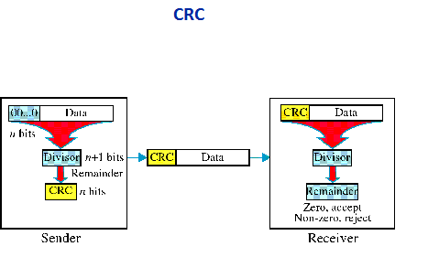

Slide 4
At the sender side, the data unit to be transmitted is divided by a predetermined divisor (binary number) in order to obtain the remainder. This remainder is called CRC.
The CRC has one bit less than the divisor. It means that if CRC is of n bits, divisor is of n+ 1 bit.
The sender appends this CRC to the end of data unit such that the resulting data unit becomes exactly divisible by predetermined divisor i.e. remainder becomes zero.
At the destination, the incoming data unit i.e. data + CRC is divided by the same number (predetermined binary divisor).

Slide 5
If the remainder after division is zero then there is no error in the data unit & receiver accepts it.
If remainder after division is not zero, it indicates that the data unit has been damaged in transit and therefore it is rejected.
CRC is based on binary division. A sequence of redundant bits called CRC or CRC remainder is appended at the end of a data unit such as byte.

Slide 6
Requirements of CRC :
A CRC will be valid if and only if it satisfies the following requirements:
It should have exactly one less bit than divisor.
2. Appending the CRC to the end of the data unit should result in the bit sequence which is exactly divisible by the divisor.

Slide 7
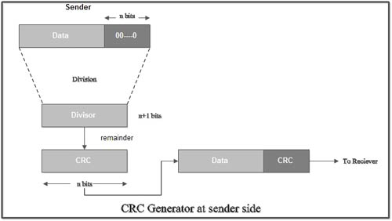
The various steps followed in the CRC method are
1. A string of n as is appended to the data unit. The length of predetermined divisor is n+ 1.
2. The newly formed data unit i.e. original data + string of n as are divided by the divisor using binary division and remainder is obtained. This remainder is called CRC.

Slide 8
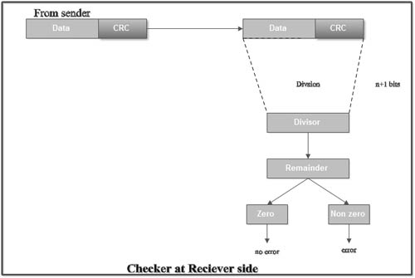
3. Now, string of n Os appended to data unit is replaced by the CRC remainder (which is also of n bit).
4. The data unit + CRC is then transmitted to receiver.

Slide 9
5. The receiver on receiving it divides data unit + CRC by the same divisor & checks the remainder.
6. If the remainder of division is zero, receiver assumes that there is no error in data and it accepts it.
7. If remainder is non-zero then there is an error in data and receiver rejects it.

Slide 10
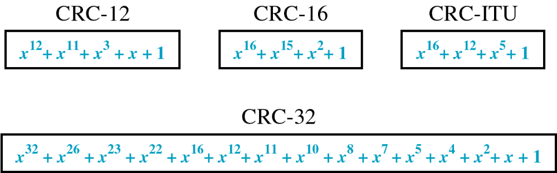
Standard Polynomials

Slide 11
Cyclic Redundancy Check (CRC)
more powerful error-detection coding
D: data bits (given, think of these as a binary number)
G: bit pattern (generator), of r+1 bits (given)
r CRC bits
d data bits
D
R
bit pattern
<D,R> = D 2^{r} XOR R
formula for bit pattern
*
goal: choose r CRC bits, R, such that <D,R> exactly divisible by G (mod 2)
  receiver knows G, divides <D,R> by G. If non-zero remainder: error detected!
  can detect all burst errors less than r+1 bits
  widely used in practice (Ethernet, 802.11 WiFi)
Link Layer: 6-<number>

Slide 12
Cyclic Redundancy Check (CRC): example
G
We want:
  D.2^{r} XOR R = nG
1
0
1
0 1 1
1 0 0 1
1 0 1 1 1 0
0 0 0
or equivalently:
  D.2^{r} = nG XOR R
1 0 0 1
1 0 1
D
2^{r}
0 0 0
*
or equivalently:
if we divide D.2^{r} by G, want remainder R to satisfy:
1 0 1 0
1 0 0 1
1 1 0
0 0 0
D.2^{r}
G
1 1 0 0
R = remainder [ ]
1 0 0 1
1 0 1 0
1 0 0 1
0 1 1
R
* Check out the online interactive exercises for more examples: http://gaia.cs.umass.edu/kurose_ross/interactive/
Link Layer: 6-<number>

Slide 13
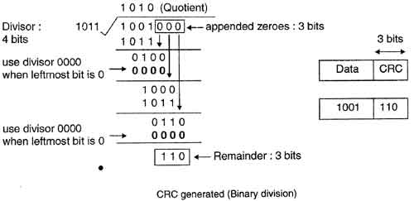
For example, if data to be transmitted is 1001 and predetermined divisor is 1011. The procedure given below is used:
Sol:
1. String of 3 zeroes is appended to 1011 as divisor is of 4 bits. Now newly formed data is 1011000.
2. Data unit 1011000 is divided by 1011.

Slide 14
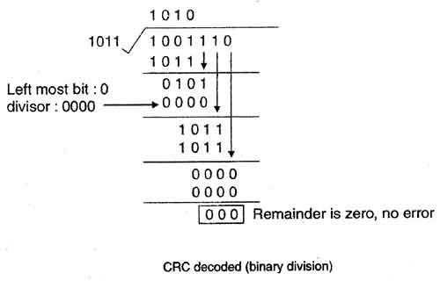
2. During this process of division, whenever the leftmost bit of dividend or remainder is 0, we use a string of Os of same length as divisor. Thus in this case divisor 1011 is replaced by 0000.
3. At the receiver side, data received is 1001110.
4. This data is again divided by a divisor 1011.
5. The remainder obtained is 000; it means there is no error.

Slide 15
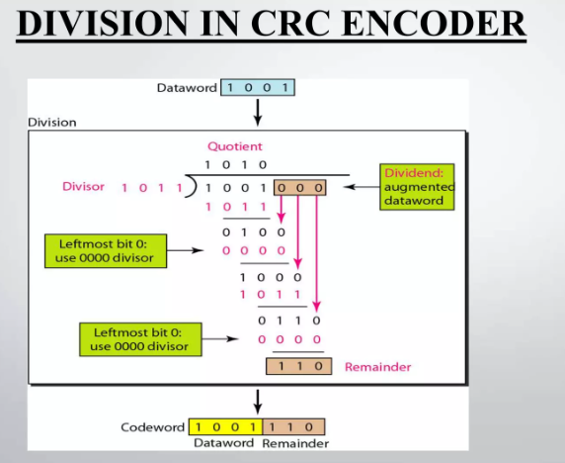

Slide 16
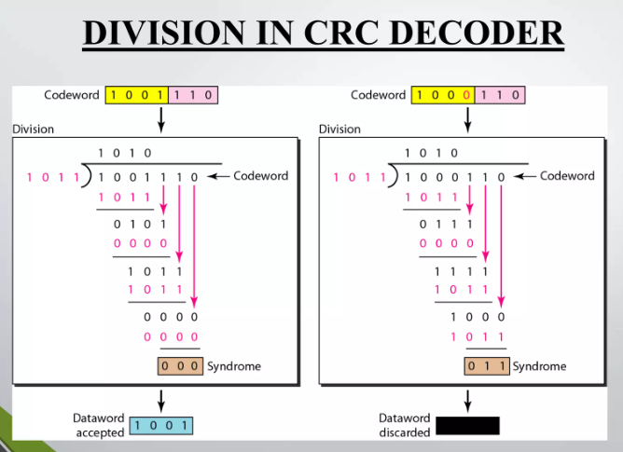

Slide 17
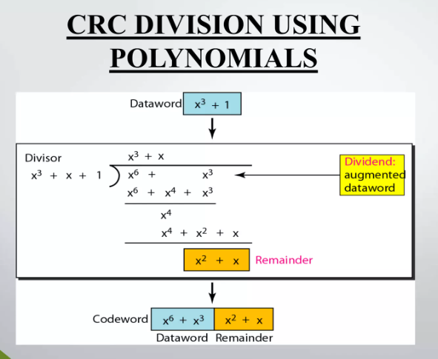

Slide 18
ALOHA
ALOHA is a system for coordinating and arbitrating access to a shared communication Networks channel.
It was developed in the 1970s by Norman Abramson and his colleagues at the University of Hawaii.
The original system used for ground based radio broadcasting, but the system has been implemented in satellite communication systems.
A shared communication system like ALOHA requires a method of handling collisions that occur when two or more systems attempt to transmit on the channel at the same time.

Slide 19
In the ALOHA system, a node transmits whenever data is available to send. If another node transmits at the same time, a collision occurs, and the frames that were transmitted are lost.
Aloha is a multiple access protocol at the datalink layer and proposes how multiple terminals access the medium without interference or collision.
In 1972 Roberts developed a protocol that would increase the capacity of aloha two fold.

Slide 20
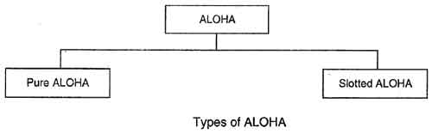
There are two different types of ALOHA:
(i) Pure ALOHA
(ii) Slottecl ALOHA

Slide 21
(i) Pure ALOHA
• In pure ALOHA, the stations transmit frames whenever they have data to send.
• When two or more stations transmit simultaneously, there is collision and the frames are destroyed.
• In pure ALOHA, whenever any station transmits a frame, it expects the acknowledgement from the receiver.
• If acknowledgement is not received within specified time, the station assumes that the frame (or acknowledgement) has been destroyed.
• If the frame is destroyed because of collision the station waits for a random amount of time and sends it again. This waiting time must be random otherwise same frames will collide again and again.
• Therefore pure ALOHA dictates that when time-out period passes, each station must wait for a random amount of time before resending its frame. This randomness will help avoid more collisions.

Slide 22
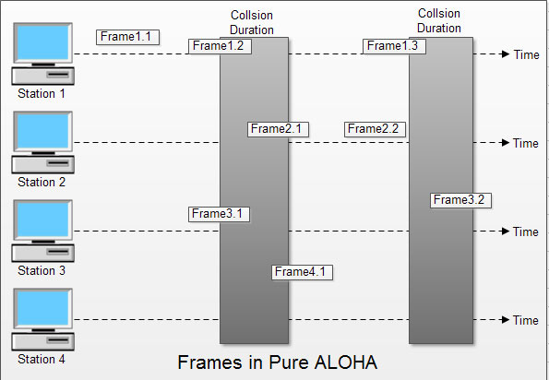

Slide 23
In fig there are four stations that .contended with one another for access to shared channel. All these stations are transmitting frames. Some of these frames collide because multiple frames are in contention for the shared channel. Only two frames, frame 1.1 and frame 2.2 survive. All other frames are destroyed.
• Whenever two frames try to occupy the channel at the same time, there will be a collision and both will be damaged. If first bit of a new frame overlaps with just the last bit of a frame almost finished, both frames will be totally destroyed and both will have to be retransmitted.

Slide 24
(ii) Slotted ALOHA
• Slotted ALOHA was invented to improve the efficiency of pure ALOHA as chances of collision in pure ALOHA are very high.
• In slotted ALOHA, the time of the shared channel is divided into discrete intervals called slots.
• The stations can send a frame only at the beginning of the slot and only one frame is sent in each slot.

Slide 25
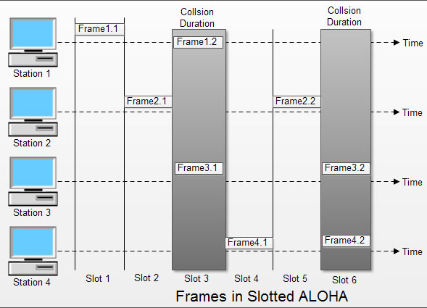

Slide 26
In slotted ALOHA, if any station is not able to place the frame onto the channel at the beginning of the slot i.e. it misses the time slot then the station has to wait until the beginning of the next time slot.
• In slotted ALOHA, there is still a possibility of collision if two stations try to send at the beginning of the same time slot as shown in fig.
• Slotted ALOHA still has an edge over pure ALOHA as chances of collision are reduced to one-half.

Slide 27
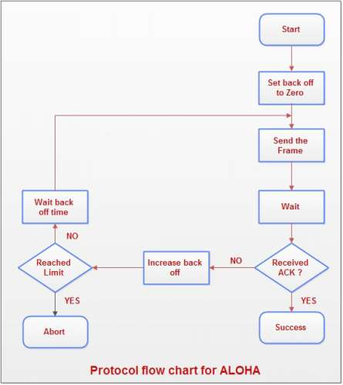
Explanation:
• A station which has a frame ready will send it.
• Then it waits for some time.
• If it receives the acknowledgement then the transmission is successful.
• Otherwise the station uses a backoff strategy, and sends the packet again.
• After many times if there is no acknowledgement then the station aborts the idea of transmission.
Protocol Flow Chart for ALOHA:

